Slide 1


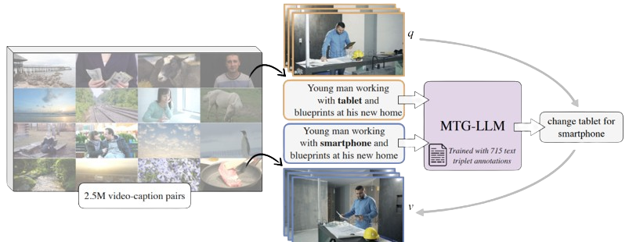
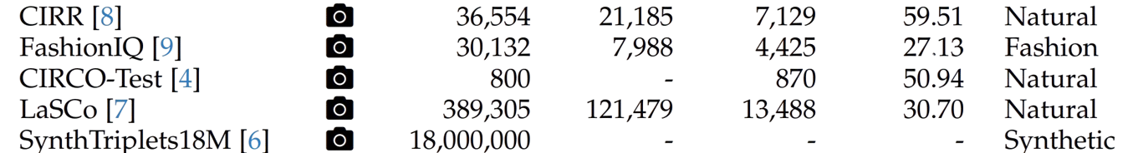
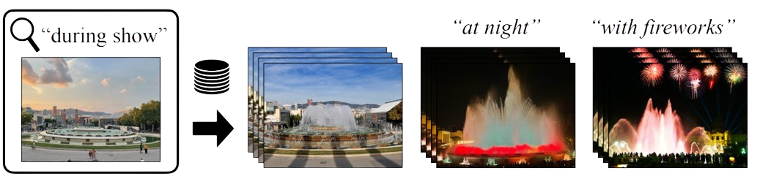
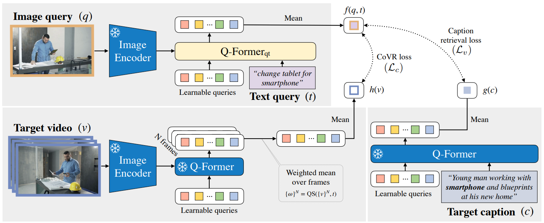
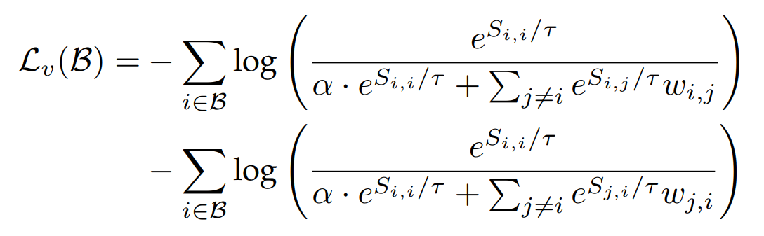

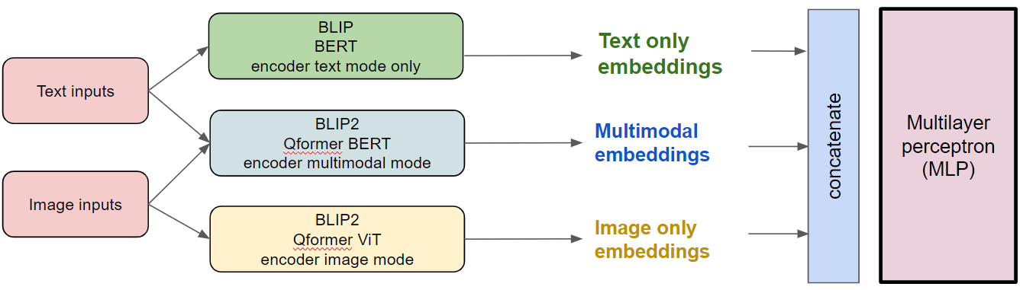
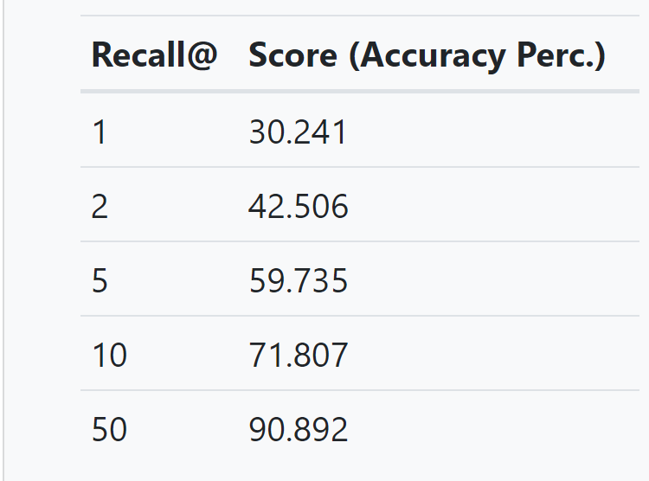
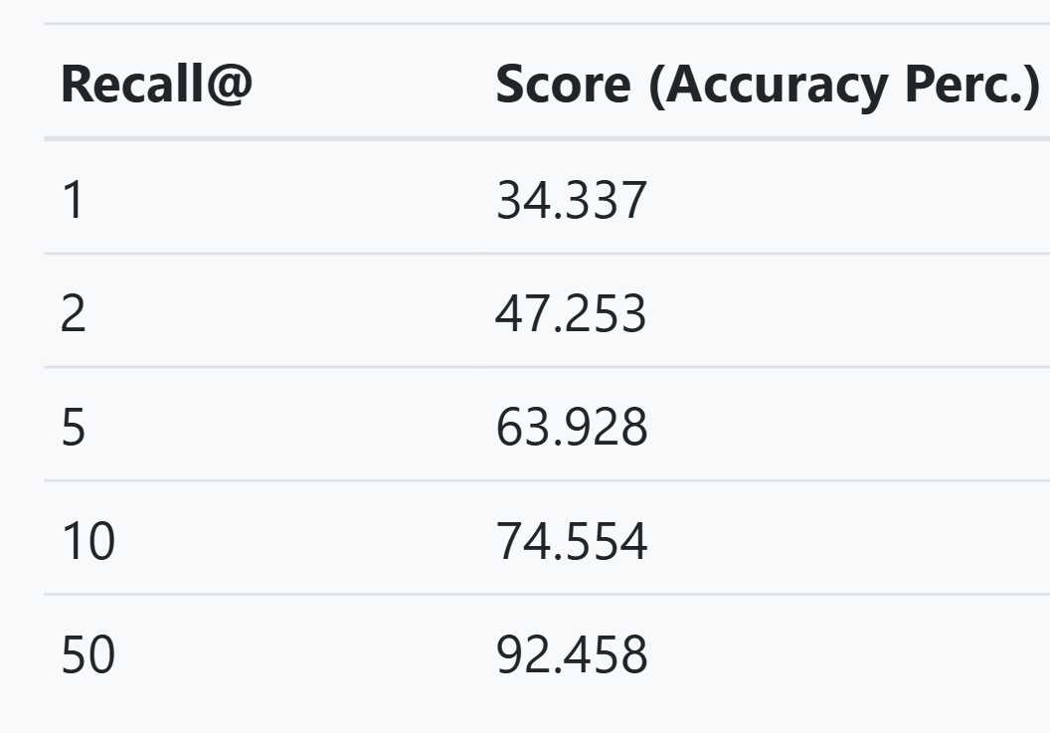
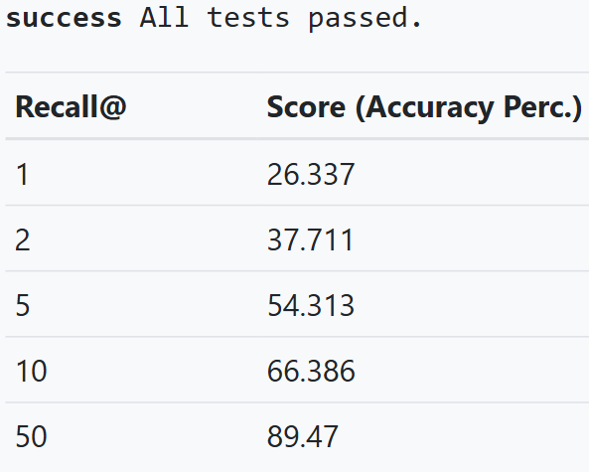

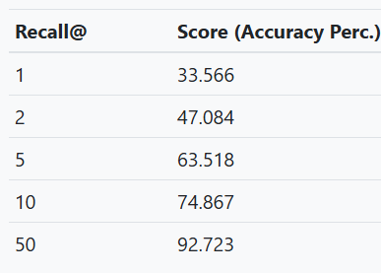
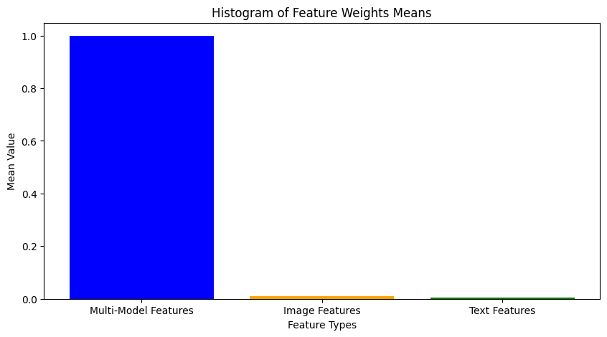
Composed Image Retrieval
RAMI Ilias¹
¹ENS Paris-Saclay
Motivation
CoVR-2
Gain of popularity of Composed Image Retrieval (CoIR) task to search for relevant images in huge dataset
Librarians: research and cataloging
Detectives: criminal investigation
Content creators: create rich visual
Travel planning: comprehensive destination visuals
Method Overview of WebVid-CoVR
Most CoIR task require manually annotated datasets, but this limits scalability because
Time-consuming
Expensive
CoVR-2: Automatic Data Construction for Composed Video Retrieval:
Scalable, automatic dataset creation methodology.
Generate triplets from video-caption pairs, expanding the scope to include Composed Video Retrieval (CoVR)
Build a novel model to respond to the CoVR task
CoVR-BLIP-2 Architecture
Works
Results
Develop a MLP to balance contributions of image, text, and multimodal embeddings
Design a consistency loss function to align multimodal, image, and text embeddings in the embedding space
I/ Reproduction of the results:
(MLP) Weighted attention framework: w1 * Visual embeddings + w2 * Textual embeddings + w3 * Hybrid embeddings
model: blip2-l-coco
model: blip2-l-coco_coir
Results
II/ Balancing contributions of image, text, and multimodal embeddings with MLP:
III/ Consistency loss
Weighted embeddings : 1/3 * Visual embeddings + 1/3 * Textual embeddings + 1/3 * Hybrid embeddings
Combine features using learned weights:
(MLP) Weighted attention framework: w1 * Visual embeddings + w2 * Textual embeddings + w3 * Hybrid embeddings
Consistency loss integration with 3 loss components :
si-ti loss: Align query (source image) with target image features
si-text loss: Align query with text features.
si-img loss: Align query with image features
Promote cross-modal consistency for enhanced embedding quality, but didn’t deal with overfiting over one feature
(MLP) Weighted attention framework: w1 * Visual embeddings + w2 * Textual embeddings + w3 * Hybrid embeddings
Conclusions
References
Next steps:
Work on the improvement of captions as the paper pointed out (Section 3.2) by using Capfilt introduced in BLIP
Consider more diverse weighting configurations for MLP
Use other consistency loss functions Experiment with more epoch and with greater batch size
L. Ventura, A. Yang, C. Schmid, and G. Varol, “Covr: Learning composed video retrieval from web video captions,” AAAI, 2023. arXiv preprint arXiv:2308.14746.
J. Li, D. Li, C. Xiong, and S. Hoi, “Blip: Bootstrapping language-image pre-training for unified vision-language understanding and generation,” 2022. arXiv preprint arXiv:2201.12086.
J. Li, D. Li, S. Savarese, and S. Hoi, “Blip-2: Bootstrapping language-image pre-training with frozen image encoders and large language models,” 2023. arXiv preprint arXiv:2301.12597.
Z. Liu, C. Rodriguez-Opazo, D. Teney, and S. Gould, “Image retrieval on real-life images with pre-trained vision-and-language models,” ICCV, 2021. arXiv preprint arXiv:2108.04024v1.

